Slide 1



intRoduction to R
Martin Peter, March 2020, GTM

Slide 2
goal of talk
Provide a short introduction to R
Inspire for broadening the interests in programming languages
Encourage for removing Excell as data transfer engine

Slide 3
intRoduction
is a programming language and free software (GNU license)
RedMonk ranking Q1/2020: 13th (1st JavaScript, 2nd Python), But constantly moving forward
is widely used for statistical computing and data mining
easy extendable via packages, large community (CRAN)
is an interpreted language available on all major platforms, interactive, exploring
dynamic data typing
basic data structures for vectors, matrices, arrays and lists
lexical scoping
call by value
everything is an object, including functions and expressions
encourages ‘functional programming’ style (no global variables, all wrapped in functions)
R v 1.0 released on Feb 29, 2000, today v 3.4.2, influenced by Lisp and particularly S in 1976
free of charge available on SwissRe workplace via simple SNOW order (Rgui, R Studio)

Slide 4
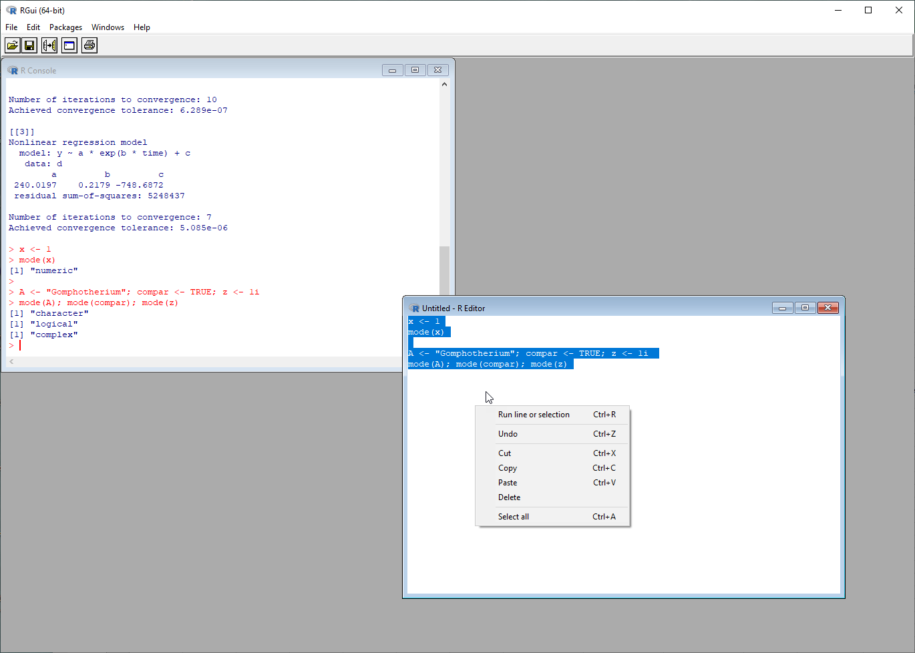
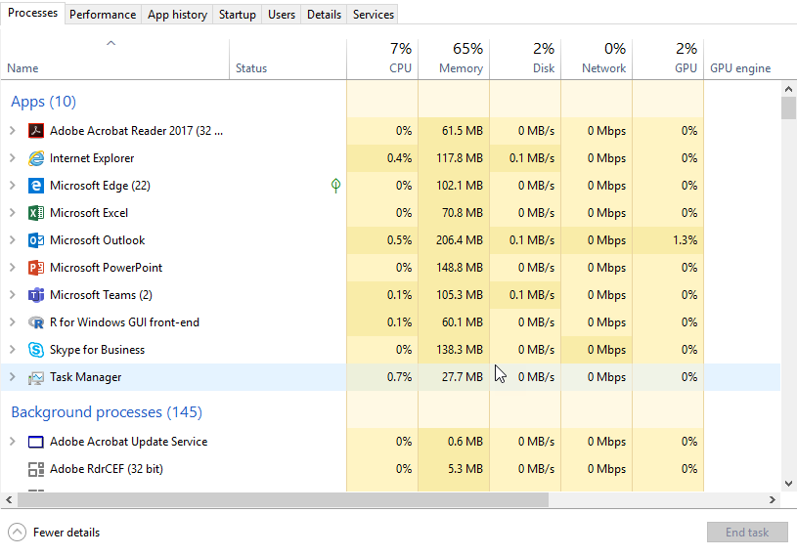
Rgui – development enviRonment

Slide 5
syntax, data types and opeRatoRs
assigned operator is <- , but = works too
no variable declarations
loops, if/else etc. all available (but wrong programming style)
install.packages(“…”); library(….)
basic data type is a object with two intrinsic attributes:
- mode = basic data type like ‘numeric’, ‘character’, ‘complex’, ‘logical’
- length = number of basic elements in the object
every object is a list
a = 5; b = 7
> a*b
[1] 35
u = c(1, 3, 5, 7); v = c(10,100,1000, 10000)
> u*v
[1] 10 300 5000 70000
functions and expressions are regular objects like any other
> x <- 1
> mode(x)
[1] "numeric"
> length(x)
[1] 1
> A <- "Gomphotherium"; compar <- TRUE; z <- 1i
> mode(A); mode(compar); mode(z)
[1] "character"
[1] "logical"
[1] "complex“
> a <- 1; b <- 2
> a+b
[1] 3
> a <- 1:10
> b <- 101:110
> a+b
[1] 102 104 106 108 110 112 114 116 118 120
f <- function(x, y) { z <- 3 * x + 4 * y; return(z) }
> f(1, 2)
[1] 11
> f(c(1,2,3), c(5,3,4))
[1] 23 18 25
> f(1:3, 4)
[1] 19 22 25
answers from R Interpreter

Slide 6
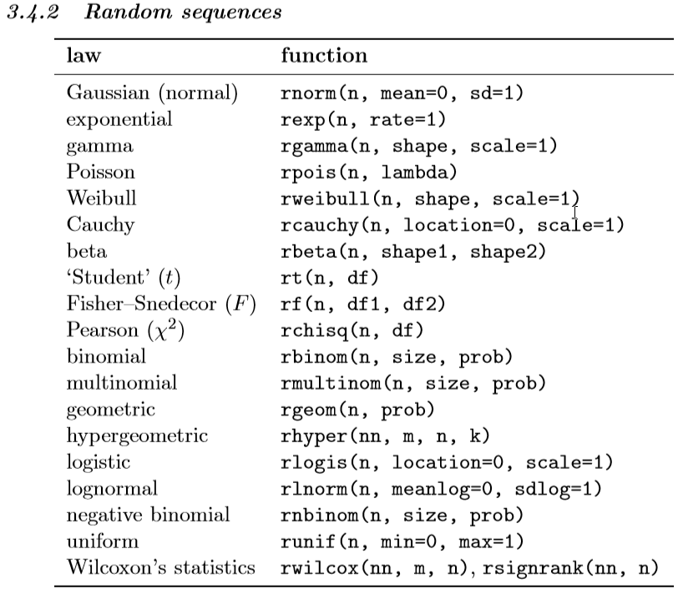
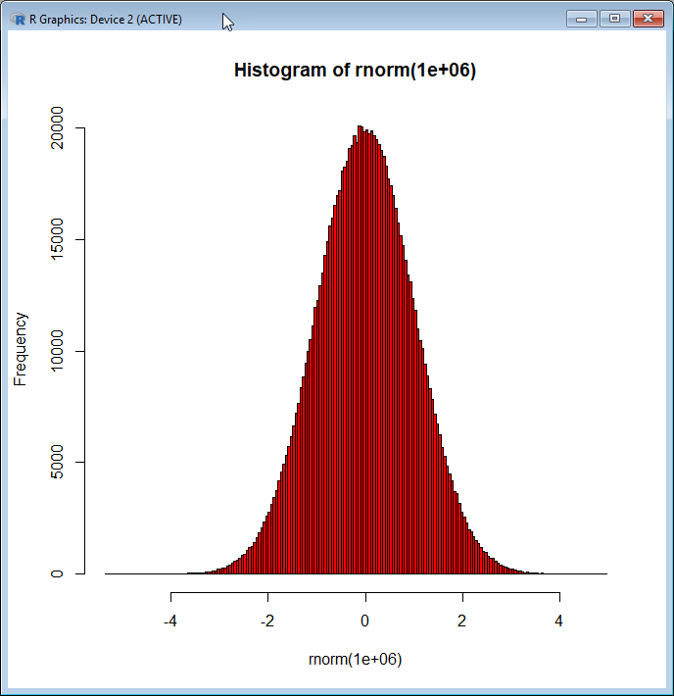
geneRating data (1/2)
Lists can be generated with lots of build in operators and statistical functions:
> y <- seq(1, 5, 0.5)
[1] 1.0 1.5 2.0 2.5 3.0 3.5 4.0 4.5 5.0
> g <- gl(2, 6, label=c("P&C", "CorSo"))
[1] P&C P&C P&C P&C CorSo CorSo CorSo CorSo
Levels: P&C CorSo
> mode(g)
[1] "numeric"
> length(g)
[1] 12
> rnorm(10, mean=0, sd=1)
[1] 0.05587940 0.41442489 -0.92940919 -0.65734926 -0.03406387 -2.25820391 -0.52374792 1.18802814 1.51562024 0.18336364
> x <- rnorm(1e6)
> length(x)
[1] 1000000
> sum(x)
[1] -81.05754
hist(rnorm(1e6), breaks=200, col=2)
answers from R Interpreter

Slide 7
geneRating data (2/2)
The same works for two dimensional structures (DataFrames, Matrices, Tibbles)
> matrix(1:6, 2, 3, byrow=TRUE)
[,1] [,2] [,3]
[1,] 1 2 3
[2,] 4 5 6
> m1 <- matrix(1, nr = 2, nc = 2) ; m2 <- matrix(2, nr = 2, nc = 2)
> m1
[,1] [,2]
[1,] 1 1
[2,] 1 1
> m2
[,1] [,2]
[1,] 2 2
[2,] 2 2
> cbind(m1, m2)
[,1] [,2] [,3] [,4]
[1,] 1 1 2 2
[2,] 1 1 2 2
answers from R Interpreter

Slide 8
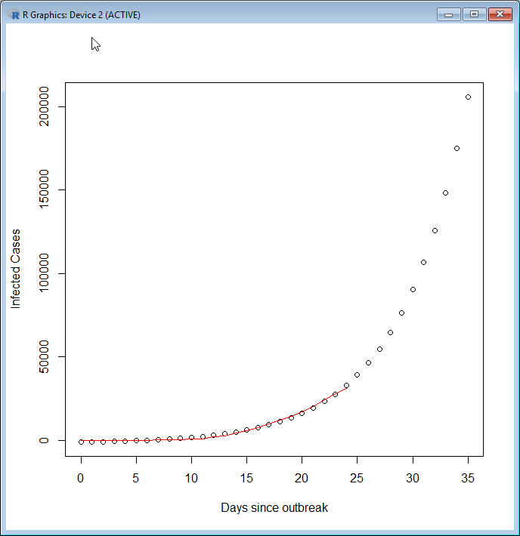



simple example
Find a fit of an exponential function to a set of observed values
# observed values
y <- c(0, 4, 4, 10, 20, 40, 140, 278, 326, 547, 639, 916, 2000, 2700, 4400, 5970, 7711, 9692, 12037, 14400, 17222, 20438, 24324, 28018, 31161)
# list of days for observation
time <- 0:(length(y)-1)
# construct table (data frame) for model calculation
df <- data.frame(time, y)
# compute exponential fit model
fit <- nls(y ~ a*exp(b*time)+c, data=df, start=list(a=65,b=0.29,c=-285))
coef(fit)
# list of days for prediction
predictTime <- 0:(length(y) + 10)
# compute prediction with the help of the model
predictY <- predict(fit,list(time=predictTime))
# plot observed data points
plot(predictTime,predictY,xlab = "Days since outbreak", ylab = "Infected Cases")
# plot prediction
lines(time, y, col = "red")

Slide 9
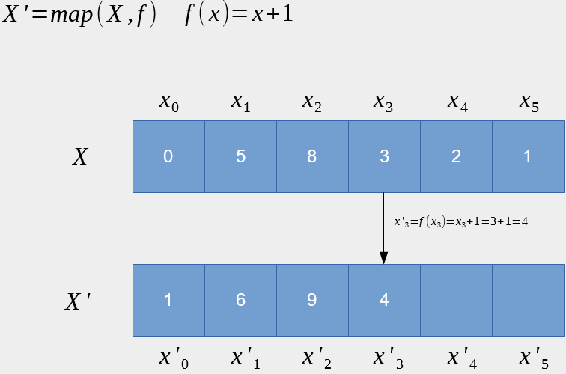
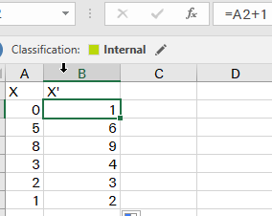
map functions
‘mapping over a domain’, meaning to apply a function to each of the elements of a domain
appeared first in Lisp 1958 available in most programming languages these days
different programming style: loops that operate on scalars vs. applying a function to a list
used with un-named functions as ‘lambda’ calculation -> functional programming
allows optimizations in compiler based on ‘math composition law’

Slide 10


map function example
operations scalars
operations on lists
MySquare = function(x) {x*x}
v <- Map(MySquare, 1:4)
> v
[[1]]
[1] 1
[[2]]
[1] 4
[[3]]
[1] 9
[[4]]
[1] 16
> length(v)
[1] 4
> mode(v)
[1] "list"
function MySquare(x) {return x*x}
for (int i = 1, i++, i < 5) {
v[i] = MySquare(i)
}
answers from R Interpreter

Slide 11
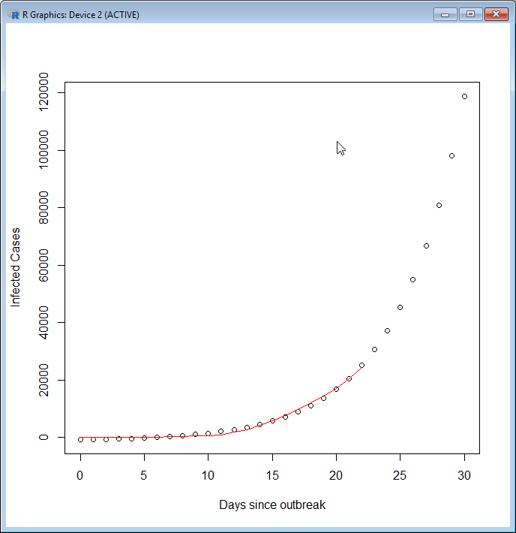
expanding the simple example to multiple scenaRios
Find a fit of an exponential function to a set of observed values
# observed values
y <- c(0, 4, 4, 10, 20, 40, 140, 278, 326, 547, 639, 916, 2000, 2700, 4400, 5970, 7711, 9692, 12037, 14400, 17222, 20438, 24324)
# list of days for observation
time <- 0:(length(y)-1)
# construct table (data frame) for model calculation
df <- data.frame(time, y)
# compute exponential fit model
fit <- nls(y ~ a*exp(b*time)+c, data=df, start=list(a=65,b=0.29,c=-285))
coef(fit)
# list of days for prediction
predictTime <- 0:(length(y) + 10)
# compute prediction with the help of the model
predictY <- predict(fit,list(time=predictTime))
# plot observed data points
plot(predictTime,predictY,xlab = "Days since outbreak", ylab = "Infected Cases")
# plot prediction
lines(time, y, col = "red")

Slide 12
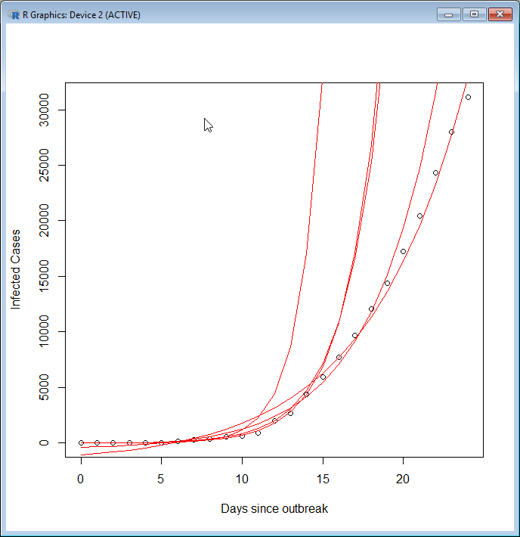









expanding the simple example to multiple scenaRios
instead of one list of observed values (y in function of time) use a list of lists
instead of one set of exponential fit parameters (fit) use a list of fits for the various scenarios
instead of one graph generate a graph for each scenario
# list of days for observation
# put the fit calculation into a function so that we can work with it
expFit <- function(d) {nls(y ~ a*exp(b*time)+c, data=d, start=list(a=100,b=0.20,c=-150))}
# create a list of subsections of the full table of observations. Basically
# a list of tables
dfList <- list(df[1:5,1:2], df[1:10,1:2], df[1:15,1:2],df[1:20,1:2], df[1:25,1:2])
# now apply the fit function of all sub tables which results in a list of
# fit parameters. E.g. a list of models
fitList <- Map(expFit, dfList)
# put the line drawing piece also in a function so that we can use it
# easily multiple times
linesFun <- function(model) { lines(predictTime, predict(model,list(time=predictTime)),col = "red")}
#plot the observed values
plot(time,y,xlab = "Days since outbreak", ylab = "Infected Cases")
# now apply the line drawing function to plot all scenarios
Map(linesFun,fitList)

Slide 13
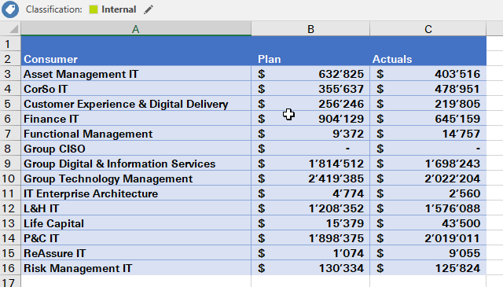
woRking with spReadsheets (1/2)
Transform a input spreadsheet to an output spreadsheet according fix instructions
library(tidyverse)
library(openxlsx)
InputFile <- "C:\\Users\\srzpem\\Desktop\\my-input.xlsx"
OutputFile <- "C:\\Users\\srzpem\\Desktop\\my-output.xlsx"
# define my own function to be used as a filter
myFilter <- function(x) ifelse( x > 10000, x, "Small")
# read the input spreadsheet
ss <- read.xlsx(InputFile, sheet = "Capre")
ss['Plan’] <- modify(select(ss, 'Plan'), myFilter)
# create the output file
write.xlsx(ss, OutputFile, sheet = "MySheet")

Slide 14
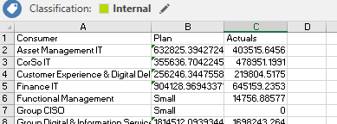







woRking with spReadsheets (2/2)
Transform a input spreadsheet to an output spreadsheet according fix instructions
> ss
Consumer Plan Actuals
1 Asset Management IT 632825.394272443 403515.646
2 CorSo IT 355636.70422451 478951.199
3 Customer Experience & Digital Delivery 256246.344755875 219804.517
4 Finance IT 904128.969433716 645159.235
5 Functional Management Small 14756.886
6 Group CISO Small 0.000
7 Group Digital & Information Services 1814512.09393441 1698243.264
8 Group Technology Management 2419385.34512551 2022204.076
9 IT Enterprise Architecture Small 2559.879
10 L&H IT 1208352.13015908 1576088.007
11 Life Capital 15379.2258899176 43500.086
12 P&C IT 1898374.53083189 2019011.217
13 ReAssure IT Small 9055.282
14 Risk Management IT 130333.964027874 125823.798
answers from R Interpreter

Slide 15

social media data example (1/3)
Search Twitter and display found words according frequency
library("twitteR"); library("tm"); library("wordcloud")
…..
# lets get some tweets
tw <- searchTwitter("swissre", n=1500, lang="en")
#and extract the text from the tweets in a vector
tw_text <- sapply(tw, function(x) x$getText())
….
wordcloud(dm$word, dm$freq, random.order=FALSE, colors=brewer.pal(8, "Dark2"), min.freq=10)

Slide 16
social media data example (2/3)
Search Twitter and display found words according frequency
load libraries with extra functions
ensure Internet access works (proxy server)
set authentication for twitter API access
search Twitter for key word and save text
manipulate data
display results
library("twitteR"); library("tm"); library("wordcloud")
Sys.setenv(http_proxy="http://gate-zrh.swissre.com:9443")
consumer_key <- ‘…'
consumer_secret <- ‘….'
access_token <- ‘….'
access_secret <- ‘…'
setup_twitter_oauth(consumer_key, consumer_secret, access_token, access_secret)
# lets get some tweets
tw <- searchTwitter("swissre", n=1500, lang="en")
#and extract the text from the tweets in a vector
tw_text <- sapply(tw, function(x) x$getText())
# create a corpus
tw_text_corpus <- Corpus(VectorSource(tw_text))
tw_text_corpus <- tm_map(tw_text_corpus, content_transformer(function(x) iconv(x, to='UTF-8', sub='byte')))
# create document term matrix applying some transformations
tdm = TermDocumentMatrix(tw_text_corpus, control = list(removePunctuation = TRUE,
removeNumbers = TRUE, tolower = TRUE))
# define tdm as matrix
m = as.matrix(tdm)
# get word counts in decreasing order
word_freqs = sort(rowSums(m), decreasing=TRUE)
# create a data frame with words and their frequencies
dm = data.frame(word=names(word_freqs), freq=word_freqs)
wordcloud(dm$word, dm$freq, random.order=FALSE, colors=brewer.pal(8, "Dark2"), min.freq=10)

Slide 17
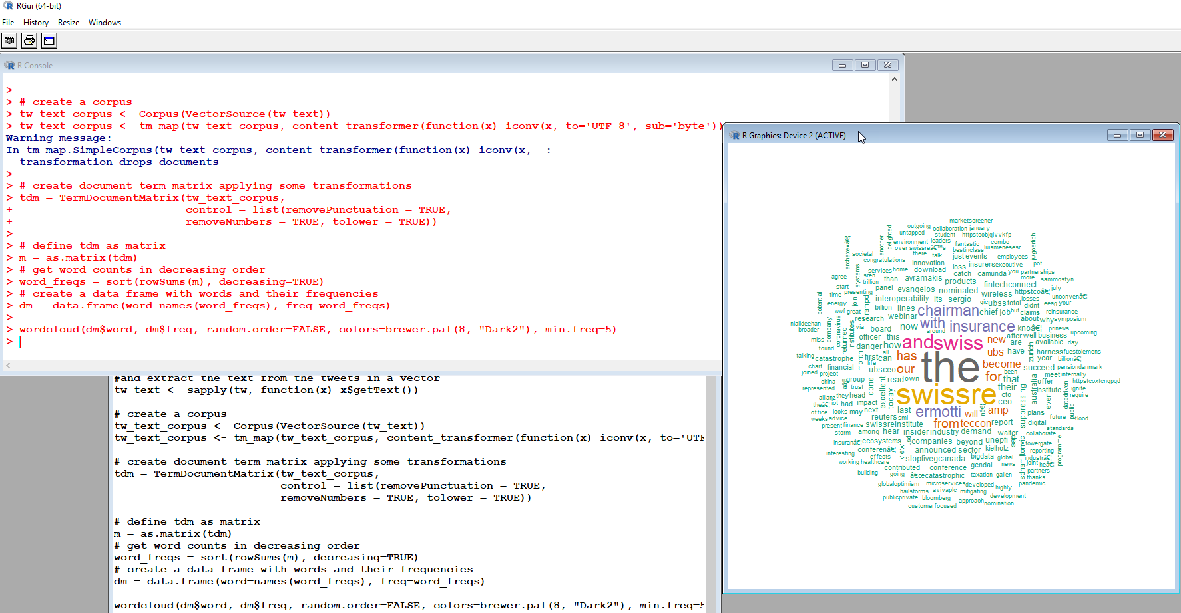
social media data example (3/3)
Search Twitter and display found words according frequency

Slide 18

public messenger example - telegRam bot

Slide 19
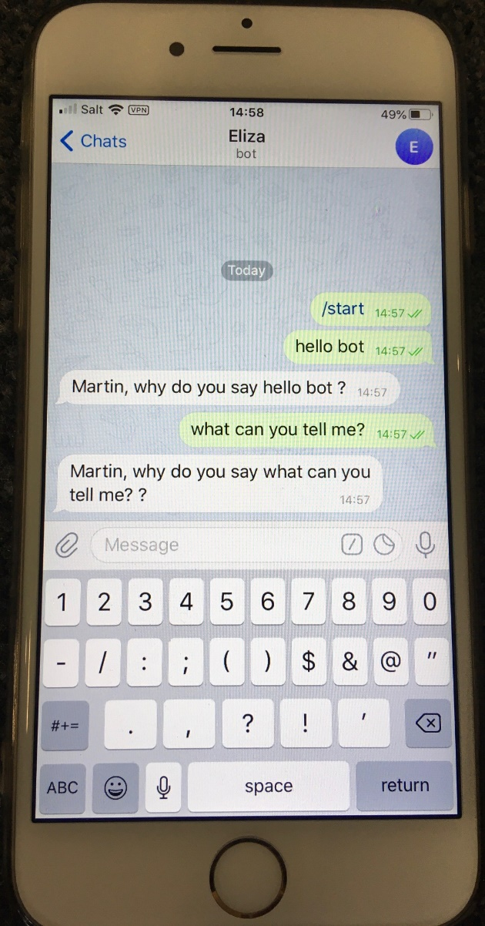
elegant code – telegRam bot example
library(telegram.bot)
Sys.setenv(http_proxy="http://gate-zrh.swissre.com:9443")
bot <- Bot(token = “xxxxxxx")
question <- function(bot, update){
bot$sendMessage(chat_id = update$message$chat$id,
text = sprintf("%s, why do you say %s ?", update$message$from$first_name, update$message$text)
)
}
updater <- updater + MessageHandler(question, MessageFilters$text)
updater$start_polling()
See https://ebeneditos.github.io/telegram.bot/
Functions as argument in ‘Callback’ list.
A less flexible Python implementation requires ~50 lines of code, not to mention Java ..

Slide 20







one more thing … bot seaRches twitteR
rudeWords <- c("idiot", "moron")
tweets <- function(bot, update, args){
if (length(args > 0L)){
GetTweet(toupper(paste(args, collapse = " ")), OutputFile)
bot$sendPhoto(chat_id = update$message$chat_id, photo = OutputFile)
}
}
updater <- updater + CommandHandler("tweets", tweets, pass_args = TRUE)
question <- function(bot, update){
if (any(str_detect(update$message$text, rudeWords))) {
bot$sendMessage(chat_id = update$message$chat$id,
text = sprintf("Don't be rude %s", update$message$from$first_name))
else {
bot$sendMessage(chat_id = update$message$chat$id,
text = sprintf("%s, why do you say %s ?", update$message$from$first_name, update$message$text))
}
}
updater <- updater + MessageHandler(question, MessageFilters$text)
updater$start_polling()

Slide 21

R – the good – the bad – the ugly
general purpose programming language
list processing, vector, matrix, pattern matching, sparse data, functional programming
large, active community contributing high quality code, package management
small footprint
great graphics capabilities
extensible to web applications
good interface to other languages
multiple platform support
sometimes syntax is a nightmare (access a element in a table for example)
variable naming gotchas: , $ used like ‘.’ in other programming languages, ‘.’ normal variable character ,’…’, variable arguments)
it’s a interpreter with one namespace which even is (can be) persistent
execution speed
multithreading
no ‘module’ concept
legacy from S3 object models (no 64bit) , corrected by packages (tidyverse)

Slide 22
References
Documentation: https://www.rdocumentation.org/
Introduction: https://cran.r-project.org/doc/manuals/r-release/R-intro.pdf
Advanced R Book: https://adv-r.had.co.nz
R Manuals: https://cran.r-project.org/manuals.html
R Inferno: https://burns-stat.com/documents/books/the-r-inferno
Efficient R Programming: https://csgillespie.github.io/efficientR
Examples Efficient R Code: https://github.com/ycrc/efficient-R
RStudio Webinars: https://resources.rstudio.com

Slide 23
Lexical Scoping
no block scoping
>a <- 1
> { a <- 2 }
> a
2
> a <- 1
> f <- function() {print(a)}
> f()
1
> a <- 1
> f <- function() { print(a) a <- 2 print(a) }
> f()
1
2> a
1
> a <- 1
> f <- function() { print(a) ; a <<- 2; print(a) }
> f()
1
2
> a
2
functions have access to environment (scope) they were created in
variables created or modified within a function stay there
variables created or modified within a function stay there unless assignment to enclosing environment (scope) is explicitly requested
answers from R Interpreter

